Slide 1
The World-Tie Project
Kevin Manzotti – kmanzotti2011@my.fit.edu
Vasudev Singhchawla – vsinghchawla2011@my.fit.edu
Patricia tolsa – pterol2011@my.fit.edu
Dylan wock – dwock2011@my.fit.edu
Faculty sponsor – Phil Bernhard – pbernhar@fit.edu

Slide 2
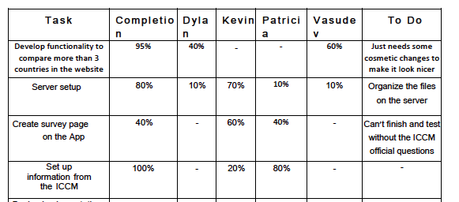
Milestone 4 Matrix

Slide 3
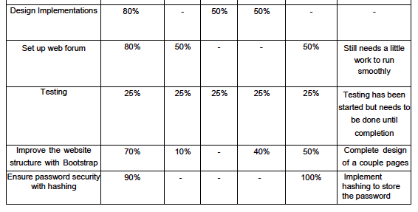
Milestone 4 Matrix

Slide 4
Summary of Accomplishments
Password security for website
Using hash
Compare three countries
Users can compare their country with two other countries of their choice
Still waiting on server from FIT to be fully functional in order to move the database onto it
Can’t implement the final forum until that is done
Re-design of website in progress
Create survey for collecting information
Testing in progress

Slide 5
Android Initial Design

Slide 6
Android Demo

Slide 7
Password Hashing
User Input – “banana”

Slide 8
Web Demo
http://my.fit.edu/~pterol2011/sekai/index.html

Slide 9
Milestone 5 Matrix

Slide 10
Questions / Comments?

