Slide 1
THE WORLD-TIE PROJECT Milestone 2
KEVIN MANZOTTI
VASUDEV SINGHCHAWLA
PATRICIA TEROL TOLSA
DYLAN WOCK

Slide 2
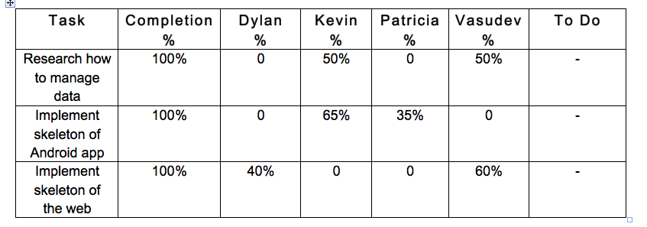
Mileston #2 matrix:

Slide 3
Summary of Accomplishments
Research how to manage the data
For sign up, log in and info retrieval
Used MySQL
One table with user info
One table with countries info from ICCM
Two more tables to de be developed with more information about countries

Slide 4
Summary of Accomplishments
Implement skeleton of Android app
Log in/ out
Store/delete/manage notes
“Forgot password” retrieval
Retrieve user status after closing/opening app
Other basic functionality
Profile page under development
Sending new forms from sign up is also under development

Slide 5
Summary of Accomplishments
Implement skeleton of the web
Functional menu
Photo slideshow
Log in
Sign up
Read about us and the ICCM
Basic open forum to submit messages
Contact page
“Forgot password” retrieval

Slide 6
Website demo
http://my.fit.edu/~vsinghchawla2011/worldtie/

Slide 7
App demo

Slide 8
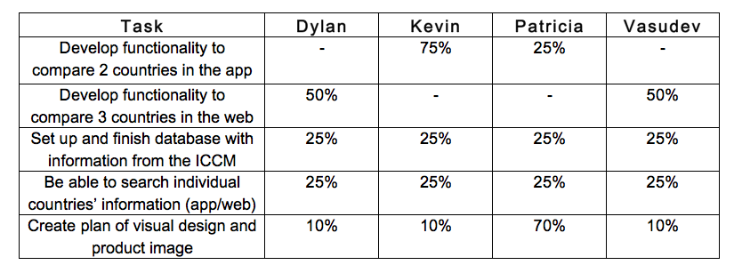
Milestone #3

Slide 9
QUESTIONS/COMMENTS?

